Slide 1
Image Classifier Using Convolutional Neural Networks
Domain - Machine Learning Group ID : 16
By- Guide :
Namrata Bodkhe (T150058521) Mrs. Jayashree Jagdale
Kajal Mohite (T150058588)
Vivek Mutha (T15005891)
Gautami Shinde (T150058636)

Slide 2
Index
Domain, Title, Problem Statement, Scope
Abstract
Motivation
Introduction
Literature Survey
Image Processing
What is CNN?
What is TensorFlow?
Comparisons of CNN models
Identifying Traffic signs with CNN
Conclusion
References

Slide 3
Domain, Title, Problem Statement,Scope

Slide 4
Domain, Title, Problem Statement, Scope
Domain - Machine Learning
Title - Convolutional Neural Network for Image recognition using Tensor Flow
Problem Statement- To classify image by Convolutional Neural Network: technology of Deep learning using TensorFlow.
Scope-
Convolutional neural Network and different layers of CNN.
TensorFlow and different types of TensorFlow.
Dataset Management and application of CNN using TensorFlow.
Domain, Title, Problem Statement and Scope

Slide 5
Abstract
The data in the real world is mostly in the form of unlabeled and unstructured format. Useful information cannot be easily derived from neural networks which are shallow i.e. the ones which have less number of hidden layers. Moreover, traditional classification methods face the noisy image problems. Hence deep neural network based convolutional neural network (CNN) classifier which has a large number of hidden layers and can derive meaningful information from images has been proposed by the researchers. The idea is of an image classification model using a convolutional neural network with TensorFlow. TensorFlow is a popular open source library for machine learning and deep neural networks.

Slide 6
TensorFlow allows you to make the most of your available hardware. It also facilitates you with the language options to execute your computational graph.
A multi-category image dataset has been considered for the classification. Conventional back propagation neural network has an input layer, hidden layer, and an output layer but convolutional neural network, has a convolutional layer, and a max pooling layer. This proposed classifier was trained to calculate the decision boundary of the image dataset. Image features extracted by a CNN have achieved the state-of-the-art performance for image classification problems.

Slide 7
Motivation

Slide 8
Motivation
Imaging can be defined as the representation of an object external form. That definition no longer holds true. More information within an image can be considered. Fluorescent tags, mechanical-biological parameters, internal structures are some of the recent additions. Fabrication while imaging and the characterization of materials as yet undefined can also be part of imaging. The extremely small images can be measured in nanometers also. Future imaging systems are expected to be less expensive. They will have to be easier to use. There are various types of imaging systems such as those used for chemical, optical, thermal, medical and molecular imaging.

Slide 9
The use of scanning techniques and statistical analyses for image analysis are needed to extract valid image values. The satellite applications programs of the future will be based on extensive research in the area of imaging. A number of different sensors will be used in the satellites orbiting the earth. Scientifically useful information will be extracted from these systems. New techniques will be needed to organize and classify the different sets of data obtainable from the orbiting satellites.

Slide 10
Introduction

Slide 11
Introduction
Digital Image processing has become the most common type of image processing
Digital image processing has several applications
Image processing is also used in autonomous cars
We wish to study the convolutional neural networks and deep learning technology for the classification of images
Such an image classification model can be used to help autonomous cars to classify between different types of road and helps it to recognize the traffic signs which prevents possible accidents on the roads.

Slide 12
Literature Survey

Slide 13
Literature Survey
Author | Title | Significance | Advantages | Disadvantages
Famao Ye, Yenfein Sun, Hui Xiao Year: 2016 | Remote Sensing Image Registration Using Convolutional Neural Network Features | Feature extraction, Remote sensing Image registration | The method used provides performance compared with state of art methods in terms of accuracy. | CNN features from other models such as AlexNet, GoogleNet and combine CNN features with other features to register image sensing images were not examined
Table 1: Literature Survey

Slide 14
Hyoungil Jeong, Youngong Ko, Jungyun Seo Year: 2016 | Classifying multi-category images using deep learning: A CNN model | Tensile stress, ML, Biological NN, ML algorithms | The proposed method has a high accuracy for classifying images and the model can be applied for solving complex image classification problem | A CPU based system was used so experiment has taken excess time
Libo Zhang, Tiejian Luo, Fei Zhang and Yanjun Wu Year: 2017 | Semi- Supervised Deep Learning Using Pseudo Labels for Hyperspectral Image Classification | Hyperspectral imaging Feature extraction NN ML Training | Experiments results have shown that proposed method significantly outperforms other state of art supervised and semi-supervised methods. | Need of exploring better ways for generating pseudo labels was felt which are more consistent to the underlying true labels.

Slide 15
Image Processing

Slide 16
Image Processing
Convert image into digital form.
Perform operation to obtain information.
It is signal dispensation in which input is image,video frame or photograph.
Output may be image or characteristics associated with that image.

Slide 17
Trends in Image Processing

Slide 18
Steps in Image Processing
Importing the image with optical scanner or by digital photography.
Analyzing and manipulating the image which includes data compression and image enhancement and spotting patterns that are not in human eyes like satellite photographs.
Output is the last stage in which results can be altered image or report that is based on image analysis.

Slide 19
Purpose of Image Processing
The purpose of image processing is divided into 5 groups.
Visualization : Observe the objects that are not visible.
Image Sharpening and restoration : To create a better image.
Image retrieval : Seek for the image of interest.
Measurement of pattern : Measures various objects in an image.
Image Recognition : Distinguish the objects in an image.

Slide 20
Types of Image Processing

Slide 21
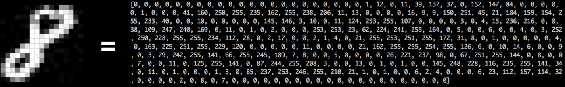
GreyScale
The image will be converted to range of grey shades from white to black.
The computer will assign each Pixel a value based on how dark it is.
All numbers are put into array and computer does the computation.
Figure 1: Grey Scale [1]

Slide 22
RGB Scale
Colors are represented as RGB values (combination of Red, Green, Blue) in the range of 0 to 255.
Computer extract the RGB value of each pixel and put it into the resultant array.
Add noise to the image using python library named imgaug.
Certain types of combination includes:
Crop parts of image.
Flip image horizontally or Rotate
Adjust saturation or contract.

Slide 23
Morphological Image Processing
The morphological operators are used to remove noise and find out edges.
One way possible is to change the grayscale image into a BINARY IMAGE, in which each pixel is restricted to a value of either 0 or 1.
Following are the morphological operations :

Slide 24
Dilation
Takes two input pieces, image to be dilated and set of co-ordinate point(Structuring Element).
Structuring Element determines effect of dilation on input image.
Mathematical definition:
X – set of co-ordinates corresponding to input binary image.
K – set of co-ordinates for structuring element.
Kx – Translation of K so that its origin is at X.
Dilation of X by K is all points “x” equal to intersection of Kx with X.

Slide 25
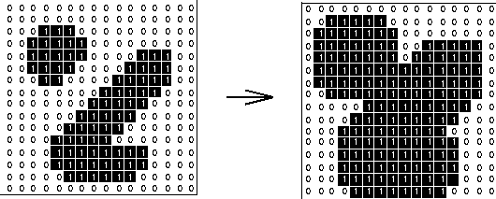
Dilation
Figure 2: Dilation [2]

Slide 26
Erosion
Takes two input pieces, image to be eroded and set of co-ordinate point(Structuring Element).
Structuring Element determines effect of dilation on input image.
Mathematical definition:
X – set of co-ordinates corresponding to input binary image.
K – set of co-ordinates for structuring element.
Kx – Translation of K so that its origin is at X.
Erosion of X by K is all points “x” such that Kx is subset of X.

Slide 27
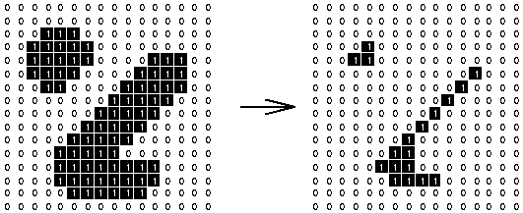
Erosion
Figure 3: Erosion [2]

Slide 28
Opening
Opening is “EROSION” followed by “DILATION”.It uses same Structuring Element for both operation.
Opening operator requires two inputs:
Image to be opened.
Structuring element.
Graylevel opening consists of graylevel Erosion by graylevel Dilation.

Slide 29
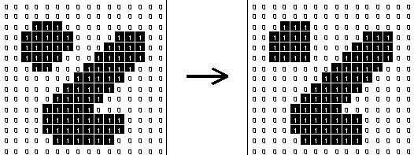
Opening
Figure 4: Opening [2]

Slide 30
Closing
Closing is reversed of Opening.
Closing is “DILATION” followed by “EROSION”.
It uses same Structuring Element for both operation.
Opening operator requires two inputs:
Image to be opened.
Structuring element.
Grey level closing is Grey level Dilation followed by Graylevel Erosion.

Slide 31
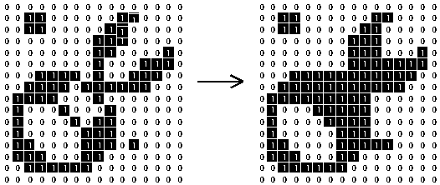
Closing
Figure 5 [2]

Slide 32
What is CNN?

Slide 33
What is Convolutional Neural Network?
CNN are mathematical model to solve an optimization problem
Made up of Neurons similar to human brains
Each Neuron takes input then performs some operation using activation function and then passes the output to following neuron.
One of the popular activation function is Sigmoid Function.
y=1/1+e-z

Slide 34
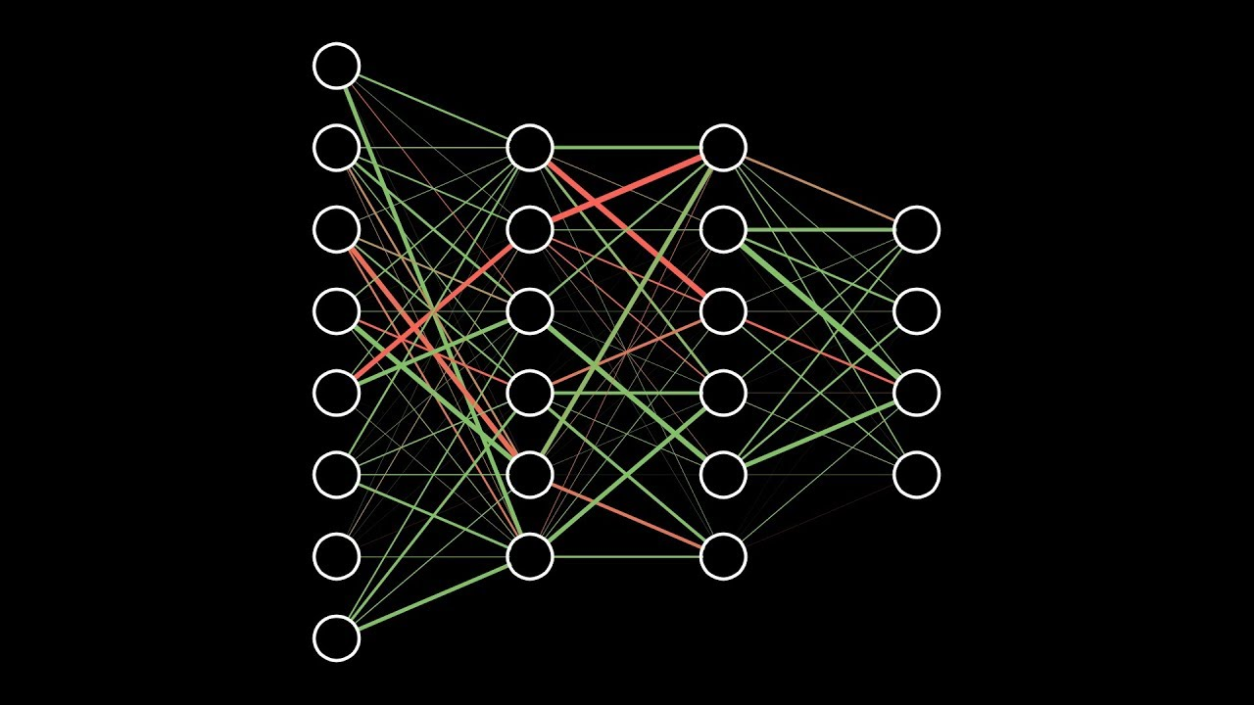
Input Layer
Hidden Layers
Output Layer
Figure 6 : CNN [6]

Slide 35
LAYERS IN CNN

Slide 36
Layers in CNN
1.Convolutional Layer
2. Pooling Layer
3. ReLU
4. Fully Connected Layer

Slide 37
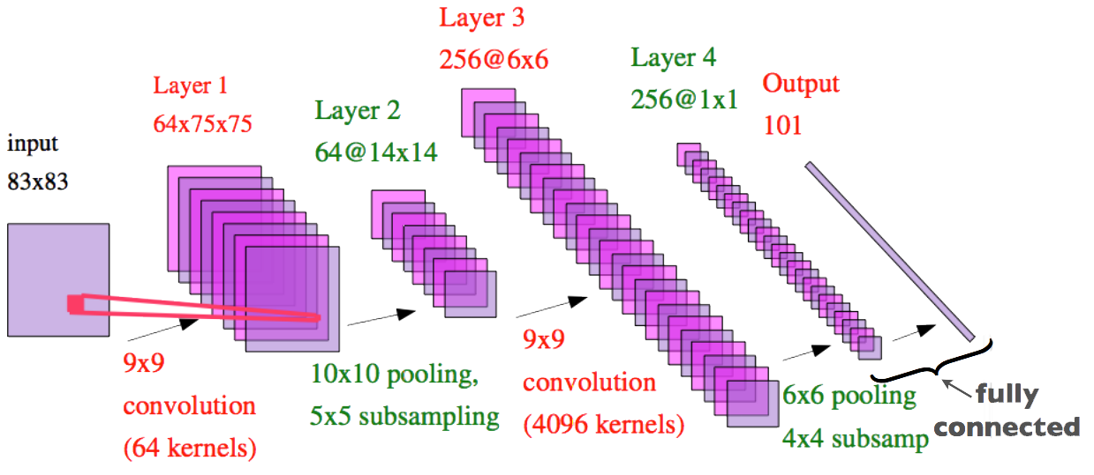
Figure 7: CNN [6]

Slide 38
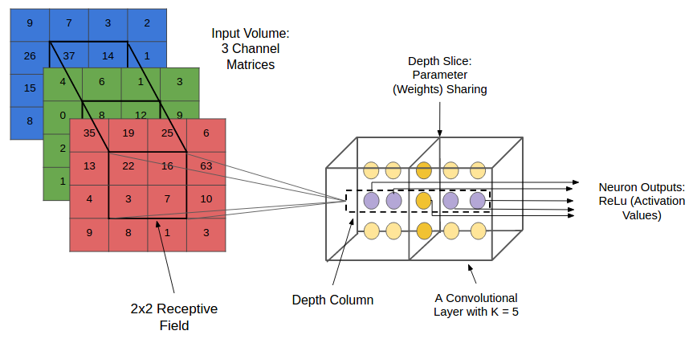
Convolutional Layer
Convolutional layers apply a convolutional operation to the input, passing the result to the next layer.
The first convolutional layer extracts low-level features like edges, lines and corners.
Higher-level layers extract higher-level features.
Each convolutional neuron processes data only for its receptive field.
Figure 8: Convolutional Layer [2]

Slide 39
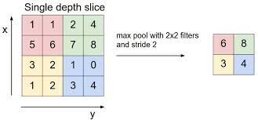
2. Pooling Layer
Pooling layer is a form of non-linear down sampling
Max pooling partitions input image into a set of non-overlapping rectangles and for each such sub-region, outputs the maximum.
The pooling layer serves to progressively reduce spatial size of representation, to reduce number of parameters and amount of computation in the network.
Figure 9 :Pooling Layer [1]

Slide 40
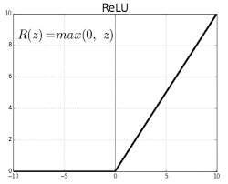
3. ReLU Layer
The rectifier function is an activation function f(x) = Max(0, x) which can be used by neurons just like any other activation function, a node using the rectifier activation function is called ReLU.
Figure 10: ReLU [1]

Slide 41
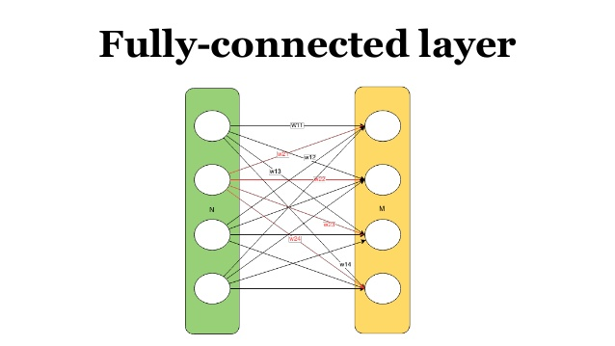
4. Fully Connected Layer
Neurons in a fully connected layer have connections to all activations in a previous layer.
The output layer in CNN is fully connected layer.
Input from other layers is flattened and sent so as transform the output into number of classes as desired by network.
Figure 10 : Fully-connected Layer[6]

Slide 42
What is TensorFlow?

Slide 43
What is TensorFlow?
TensorFlow is the second machine learning framework that Google created.
Used for design, build and train deep learning models.
“TensorFlow” is derived from operations which neural networks perform on multi-dimensional data arrays or tensors. It’s a flow of tensors.

Slide 44
COMPARISON OF CNN MODELS

Slide 45
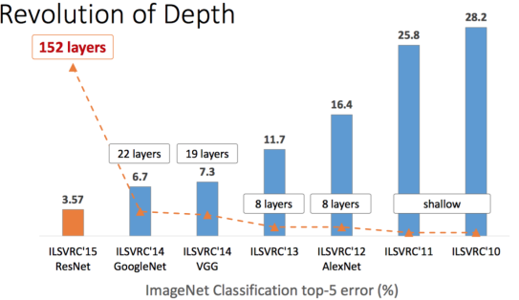
CNN MODELS
1.ALEXNET.
2.VGGNET.
3.GOOGLENET.
Figure 11: CNN Models [6]

Slide 46
ALEXNET
This architecture was one of the first deep networks to push ImageNet Classification accuracy by a significant stride in comparison to traditional methodologies.
AlexNet significantly outperformed all the prior competitors and won the challenge by reducing the top-5 error to 15.3%.
It is composed of 5 convolutional layers followed by 3 fully connected layers,
The network has 62.3 million parameters, and needs 1.1 billion computation units in a Forward pass.
AlexNet was trained simultaneously on two Nvidia Geforce GTX 580 GPUs which is the reason for why their network is split into two pipelines

Slide 47
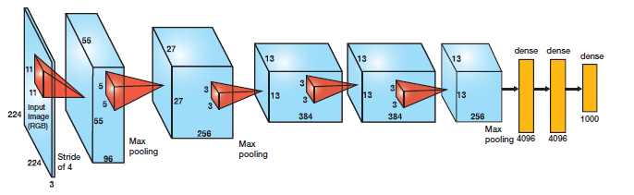
ALEXNET
It uses ReLu(Rectified Linear Unit) for the non-linear part, instead of a Sigmoid function ReLu is given by
F(x) = max(0,x)
Advantage of the ReLu over sigmoid.
In the architecture Relu is put after every convolutional and FC layers.
Figure 12: AlexNet [1]

Slide 48
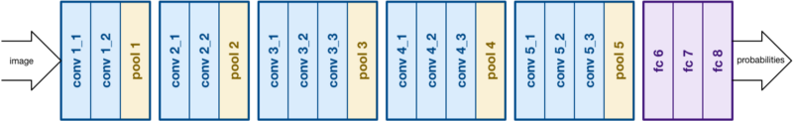
VGGNET
Built by: Visual Geometry Group
Top-1 Accuracy: 70.5%
Top-5 Accuracy: 90.0%
VGGNet consists of 16 convolutional layers and is very appealing because of its very uniform architecture.
It makes the improvement over AlexNet by replacing large kernel-sized filters with multiple 3X3 kernel-sized filters one after another.
Figure 13: VGGNet [2]

Slide 49
VGGNET
It is currently the most preferred choice in the community for extracting features from images.
The weight configuration of the VGGNet is publicly available and has been used in many other applications and challenges as a baseline feature extractor. However, VGGNet consists of 140 million parameters, which can be a bit challenging to handle.
Deployment on even the most modest sized GPUs is a problem.

Slide 50
GOOGLENET
Built by:GOOGLE
It achieved a top-5 error rate of 6.67%! This was very close to human level performance
Their architecture consisted of a 22 layer deep CNN but reduced the number of parameters from 60 million (AlexNet) to 4 million.
The GoogLeNet builds on the idea that most of the activations in deep network are either unnecessary(value of zero) or redundant because of correlations between them.
GoogLeNet devised a module called inception module that approximates a sparse CNN with a normal dense construction.

Slide 51
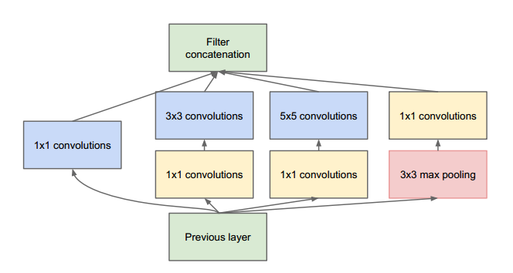
GOOGLENET
Another salient point about the module is that it has a so-called bottleneck layer. It helps in massive reduction of the computation requirement
Another change that GoogLeNet made, was to replace the fully-connected layers at the end with a simple global average pooling which averages out the channel values across the 2D feature map, after the last convolutional layer.
Use of a large network width and depth allows GoogLeNet to remove the FC layers without affecting the accuracy. It achieves 93.3% top-5 accuracy on ImageNet and is much faster than VGG.
Figure 14 : GoogLeNet [6]

Slide 52
Why are GPUs necessary for training CNN models?
GPU
A GPU is an electronic circuit unit that is designed to rapidly manipulate and alter memory to increase the rate at which the system builds images in a frame.
Graphical Processing Unit
Thousands of concurrent threads.
Hundreds of simpler cores
CPU
A central processing unit (CPU) is the hardware within a computer system that carries out the instructions of a computer program by performing the basic arithmetical, logical, and input/output operations of the system.
Central Processing unit.
Single thread performance
Few very complex cores

Slide 53
THE FUTURE OF CNN
Among the promising areas of neural networks research are recurrent neural networks (RNNs) using long short-term memory (LSTM).
These areas are delivering the current state of the art in time-series recognition tasks like speech recognition and handwriting recognition. RNN/autoencoders are also capable of generating handwriting/
speech/images with some known distribution
Deep belief networks, another promising type of network utilizing restricted Boltz-man machines (RMBs)/ autoen-coders, are capable of being trained greedily, one layer at a time, and hence are more easily trainable for very deep networks.

Slide 54
Identifying Traffic Signs With Deep Learning

Slide 55
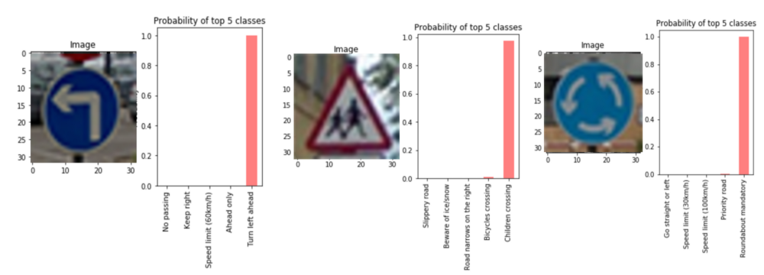
Deep Learning
Deep learning is a class of machine learning technique where artificial neural network uses multiple hidden layers.
It first identifies low level features and then learns to recognize and combines these features to learn more complicated patterns.
Figure 15: Traffic Signs Recognition [2]

Slide 56
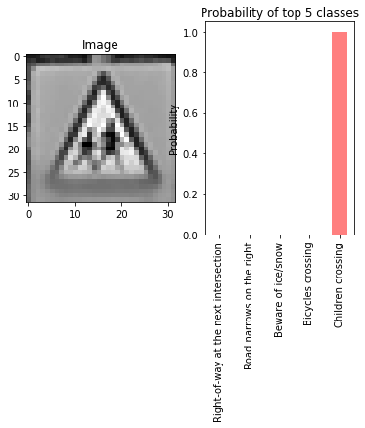
Above image shows us how image is assigned with different probabilities of top five classes of classification.
Here is one with children crossing roads.
Ref:google
Figure 16: Image processing [1]

Slide 57
Model Architecture and Hyper parameters
Tensorflow is used to implement deep conv net for traffic sign classification.
RELU was used for activation to introduce non linearity and drop out of varying percentages was used to avoid overfitting at different stages.
Model was trained for 40 epochs for 256 batch size using learn rate initially was set to 0.0001 which was further increased to 0.001 for converging to target accuracy.

Slide 58
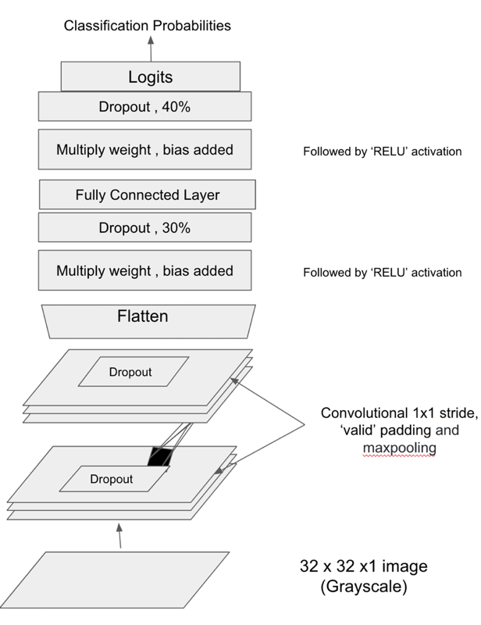
Using CNN
Figure 17: Image processing using CNN [1]

Slide 59
Dropout and Flatten
This layer drops out random set of activations in that layer by setting them to 0.
Now, what are the benefits of such a simple and seemingly unnecessary and counterintuitive process?
Well, in a way, it forces the network to be redundant.
We need to convert the output of the convolutional part of the CNN into a 1D feature vector, to be used by the ANN part of it. This operation is called flattening.

Slide 60
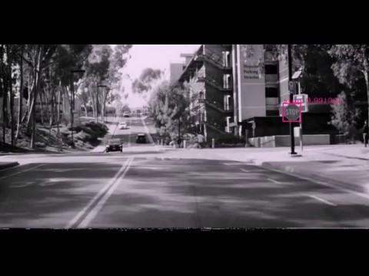
Video 1 [7]

Slide 61
Conclusion

Slide 62
Conclusion
CNN gives the best performance in pattern/image recognition problems and outperforms humans in certain areas. The technique can be applied for recognizing traffic signs and different types of roads with different cases, achieving the best performance.
There are many possibilities for improvement, such as building more complex models, or using other neural network models.

Slide 63
References

Slide 64
References
https://medium.com/@tifa2up/image-classification-using-deep-neural-networks-a-beginner-friendly-approach-using-tensorflow-94b0a090ccd4
https://medium.com/@tifa2up/image-classification-using-deep-neural-networks-a-beginner-friendly-approach-using-tensorflow-94b0a090ccd4
http://ieeexplore.ieee.org/document/8105856/
http://ieeexplore.ieee.org/document/8256731/?reload=true/
http://ieeexplore.ieee.org/document/8245905/
https://en.wikipedia.org/wiki/Convolutional_neural_network
https://www.youtube.com/watch?v=2oPNwUc2UkQ

Slide 65
THANK YOU!

